Slide 1
Cancer Biology Biol 445
Spring 2020
Dr. Heidi Super
Lecture 17
3-4-2020

Slide 2
It’s that time again! Quiz 3 on Monday.
Midterm grades Monday. Includes Quiz 1 and 2 and graded writing/assignments.
Topics list today

Slide 3
Where were we?
Tumor suppressor genes-
LOH—what is this? How is it noted and how is it related to TS genes?
RB gene—in humans, locus is on chromosome 13. What does RB protein do? Why is it considered a tumor suppressor protein?
How does HPV work, in part to cause cancer?

Slide 4
How does loss of Rb dysregulate cell division?
Figure 10-3

Slide 5
Cells need to release pRb from E2F when growth factors are signaling necessary cell division.
Loss of pRB genes result in loss of the pRb-mediated restraint on cell division. E2F is free to activate S-phase associated genes.

Slide 6
Discovery of Rb, led to a new understanding of viruses and cancer!
Some oncogenic viral proteins inappropriately associate with-- or phosphorylate Rb.
E.g. Human Papillomavirus (HPV) encodes a protein called E7. E7 competes with E2F for binding to RB. Therefore, E7 acts to inhibit the activity of pRB.

Slide 7
Part of HPV’s effect on cervical cells is via E7-pRb interaction.
Cells infected with HPV will proliferate more rapidly than their uninfected neighbors

Slide 8
Specific HPV strains (16, 18) are considered higher risk for inducing cervical cancer. They express higher levels of E7 protein.
HPV actually has “double whammy” effect on cell cycle control. Another protein produced by HPV interacts with ANOTHER tumor suppressor—p53!

Slide 9
P53—another TS gene/protein
p53 is essential for both cell cycle arrest/temporary pauses --for repair AND initiation of apoptosis---when DNA/cellular deficiencies are not repairable.
When p53 is not made or degraded abnormally….
Cells with DNA damage keep proliferating, accumulating more damage….

Slide 10
p53
Read more in your chapter. How, exactly, does p53 protect the cell against tumors. What are some of the proteins p53 interacts/works with?

Slide 12
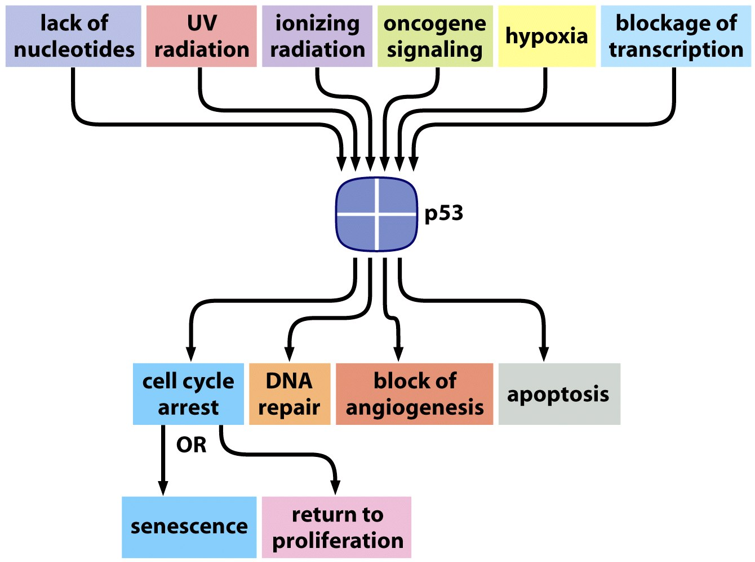
More p53…senses many potential hazards for cellular health
p53 binds to itself and works in complexes of 4---tetramers of p53.

Slide 13
Interesting feedback loop to regulate p53 levels in the cell
p53 is a transcription factor. One of its gene targets is Mdm2.
The more p53, the more Mdm2 is produced which, in turn leads to the destruction of p53. p53 regulates its own activity via Mdm2.

Slide 14
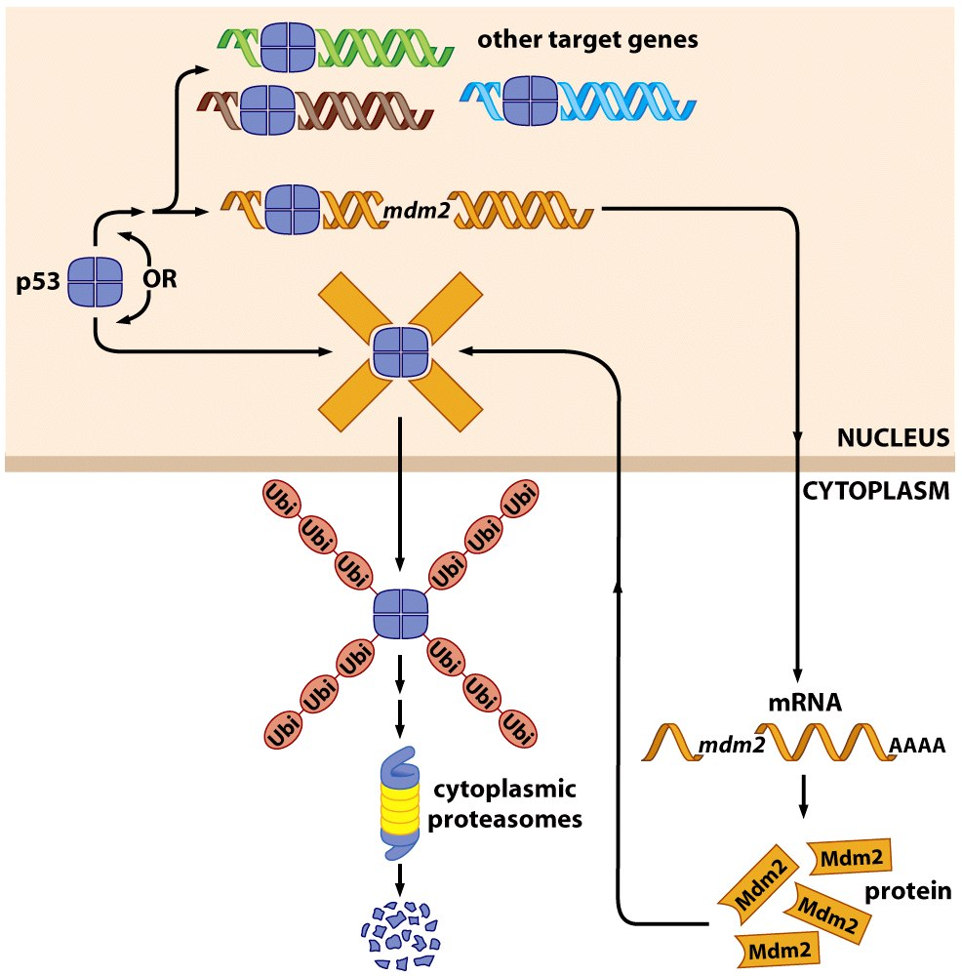
Figure 9.11 The Biology of Cancer (© Garland Science 2007)

Slide 15
Figure 9.11 The Biology of Cancer (© Garland Science 2007)

Slide 16
How was p53 noticed? What are its links to cancer?
Again, mice have been used to study the importance of many specific genes in initiation, and progression of tumors.

Slide 17
It was noted that a common locus showed LOH in cells of many types of cancer. Narrowed to a gene, we now know as p53
2. Mice were developed to have one or both p53 genes disabled and then tested for development of tumors and survival.

Slide 18
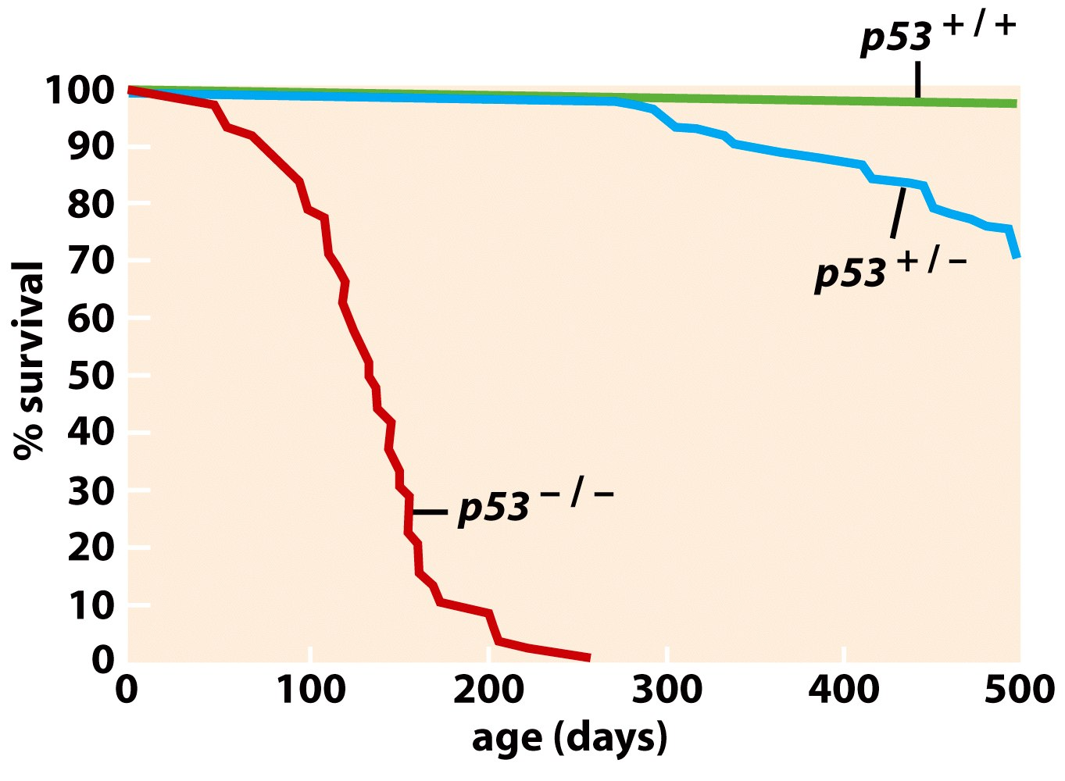
Figure 9.5 The Biology of Cancer (© Garland Science 2007)

Slide 19
It was puzzling at first why a heterozygote would show any effect with respect to cancer/survival.
After all a tumor suppressor gene should act in a recessive manner. (Both normal copies must be inactivated to show the phenotype)

Slide 20
Further study showed that p53 protein can bind wild-type or mutant p53. When the tetramer consists of some mutant p53, it inhibits its normal function.
When the mutant form of a protein binds and disables the wt, we call this a dominant negative type of mutation.
10-7

Slide 21
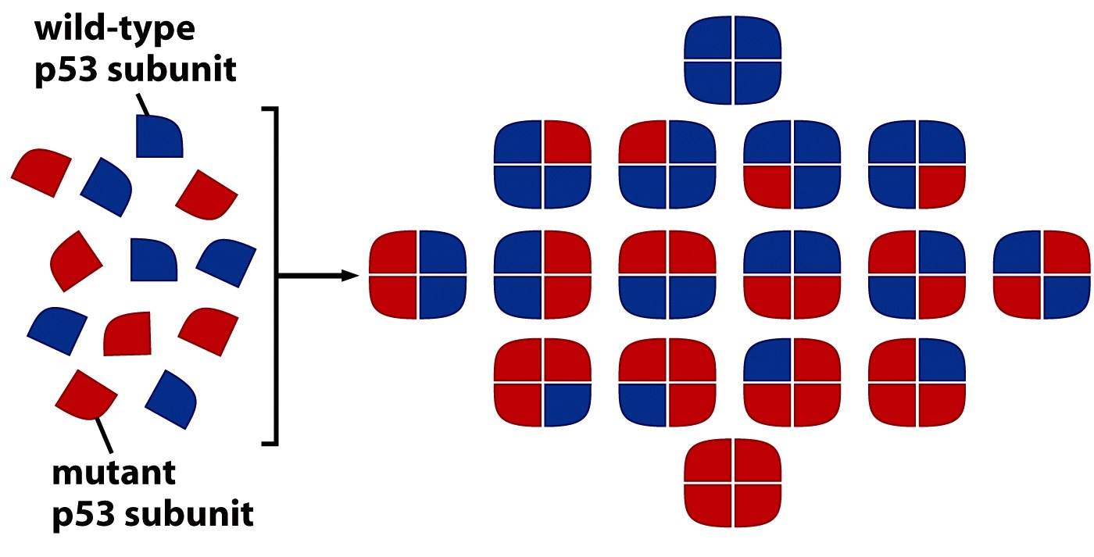
Figure 9.7b The Biology of Cancer (© Garland Science 2007)

Slide 22
3. It was identified as a loss of function mutation is another disease that runs in families.
Li-Fraumeni Syndrome
Puts individuals at much higher risk for many types of cancer.
https://ghr.nlm.nih.gov/condition/li-fraumeni-syndrome

Slide 23
Li-Fraumeni syndrome
Named for 2 geneticists who showed the families shared germline p53 mutation.
Li-Fraumeni Syndrome is suspected if the following three criteria are met:
the patient has been diagnosed with a sarcoma at a young age (below 45),
a first-degree relative has been diagnosed with any cancer at a young age (below 45),
and another first-degree or a second-degree relative has been diagnosed with any cancer at a young age (below 45) or with a sarcoma at any age.

Slide 24
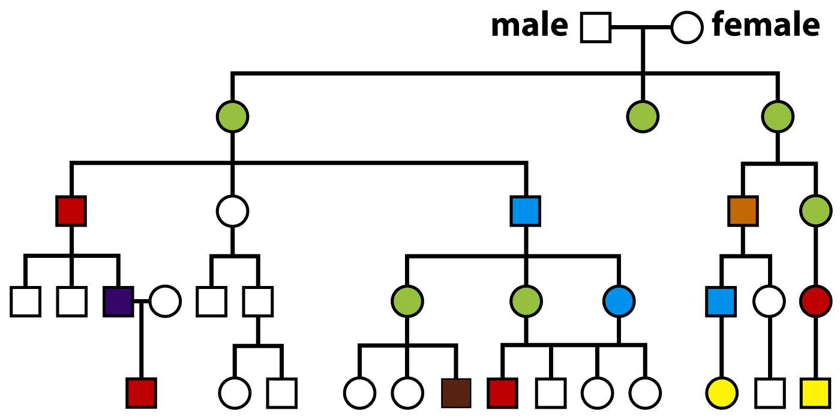
Green=breast cancer
Blue=pancreatic cancer
Purple =lung cancer
Yellow=leukema
Red=all sarcomas
Figure 9.20 The Biology of Cancer (© Garland Science 2007)

Slide 25
Why would a germline mutation in p53 cause something like Li-Fraumini syndrome?
Use Knudson’s theory in your explanation.

Slide 26
4. HPV (and other viruses associated with cancer) were shown to interact with p53 and disable it---

Slide 28
The double whammy of HPV proteins---inactivating or degrading the cell’s most important tumor suppressors.

Slide 29
Let’s return to HPV
Is HPV a big deal? YES!! It’s a STD.
~80% of the population is infected with HPV by age 50. Cause of genital warts.
HPV linked to cervical cancer (specific strains that express lots of E6 and E7 protein—we understand this now). Worldwide~500,000 cases of cervical cancer each year! ~200,000 deaths.
Anal and Oral cancers also associated.
A vaccine is available that will prevent establishment of HPV infection!!!

Slide 30
Cevarix
Gardasil
Protect against 9 HPV strains (HPV-16, 18, 31, 33, 45, 52, 58, 6, 11) that cause 70% of cervical cancers.
Protect against HPV strains that cause 90% of genital warts.
Now available for both boys and girls. (Vaccine can be given from age 9-26). Optimal age~11 or 12

Slide 31
2008 Nobel prize
Harald zur Hausen---linking HPV to cervical cancer. Paved the way for vaccine development.

Slide 32
A number of viruses disrupt normal function of pRb, p53 or both!
HPV
SV40 virus
Adenovirus
polyomavirus
HTLV (human leukemia virus)
Epstein-Barr virus—associated with mononucleosis and Burkitt’s lymphoma

Slide 33
Last tumor suppressor gene we will discuss in detail
2. CDKN2A gene
---Very interesting gene—it encodes 2 TS proteins at the same time!
The same DNA sequence can be read in 2 different reading frames. Changes the amino acid sequence, but produces 2 functional proteins: p16 and ARF

Slide 34
Alternative splicing of one mRNA creates 2 different messages for translation.
Figure 9.14 The Biology of Cancer (© Garland Science 2007)

Slide 35
p16 normally inhibits the activity of cyclin-CDK pairs which phosphorylate pRB.
Arf normally inhibits the activity of Mdm2.
Figure 10-11

Slide 36
Before we move forward---hypothesize why these genes are also considered tumor suppressors?
What have you learned about pRB and its activity?
What have you learned about p53?
How is p53 regulated?
How is pRB activated?

Slide 37
Interesting and puzzling that mammals have a single DNA region so important to normal cell division!
Loss/serious alteration of this region, disrupts our 2 most important TS gene pathways.

Slide 38
Summarizing…
Thus far we have summarized the tumor suppressor genes we consider Gatekeeper genes.
These play some role in stopping an important signal transduction pathway that ultimately leads to cell division OR they play a role in inducing cell cycle pause or apoptosis.

Slide 39
Second type of TS gene/protein
Also protect the cell, but indirectly, by limiting mutation rate for all genes .
These are sometimes called the CARETAKER genes to clarify a different type of activity.
Examples--
DNA repair proteins (introduced briefly before)
Mitotic spindle regulators

Slide 40
Loss of function mutations in these genes set the stage for genetic instability.
Increases the likelihood that proto-oncogenes are altered (overactive or amplified) to become oncogenes.
Increases the likelihood that TS genes are inactivated.

Slide 41
Again, inherited/familial types of cancer revealed the existence of some of these genes/proteins.
Why? Because, even if both alleles of a gene must be mutated to cause disease, inheriting one defective allele greatly increases the rate/likelihood that the second “hit” will occur in the same cell. Whose hypothesis?...

Slide 42
Cancers associated with defective DNA repair.
1. HNPCC---hereditary nonpolyposis colon cancer (formerly known as Lynch syndrome)
Linked to recessive mutation in mismatch repair gene. Incredibly important as DNA mismatches occur during DNA replication all the time!
Left, unrepaired, a second round of replication changes the DNA sequence forever in one of the daughter cells.
Figure 2-7

Slide 43
Familial HNPCC actually looks like a dominant genetic disease!
Once a cell loses the ability to perform mismatch repair, the rate of mutation of other critical cancer-related genes is rapid and frequent.
No need for additional outside mutagenic forces.
Figure 10-12

Slide 44
About 75% of people who inherit a mutation on one of the mismatch repair protein genes eventually develop colon cancer!
Smaller risk for uterine, stomach, kidney, and ovarian cancer.
Little risk for other types of cancer.

Slide 45
Xeroderma pigmentosum
Another cancer syndrome associated with increased skin cancer risk.
Result of defective excision repair. Type of repair needed to fix pyrimidine dimers induced by UV radiation.2-15

Slide 46
Since XP requires exposure to UV to establish genetic instability, this syndrome essentially takes an additional “hit” to develop, compared to HNPCC.
Since skin cells are the most readily targeted cell type for UV radiation, this repair defect is associated specifically with skin cancer.

Slide 47
BRCA1 and BRCA2
Once thought to be oncogenes, both encode double-strand repair proteins.
When missing from a cell, the cell is much more prone to DNA damage by agents that induce DS breaks.

Slide 48
BRCA1/2 interactions
10-13---Recall ATM. Activated by DNA damage of various kinds.
ATM activates p53 allowing it to pause cell cycle.
ATM also activates BRCA1 to participate in homologous DNA repair. (joins Rad50 exonulease complex).

Slide 49
BRCA2 interacts with a second complex (Rad51) to a second step in ds DNA repair.
10-13.

Slide 50
Assignment…
Re-read chapters 9 and 10.
Read chapter 8---Heredity and Cancer---p. 140-152 (through first paragraph).
Re-read the Hallmarks paper---highlight genes you know about and get you gene table up to date.

